Slide 1
Principle of Software Testing
Ha Nguyen

Slide 2



Agenda
Software Development Lifecycles and Testing
Software Testing Overview
Manual Testing and Automation Testing

Slide 3

Software Development Lifecycles and Testing
Software Development Lifecycles and Testing
Waterfall Model
Scrum Model
Testing Phases and Milestones

Slide 4
Software Development Lifecycles and Testing
How testing is directly affected by the Software Development Lifecycles choice:
Documentation availability to test against
Time to test
Time to automate or produce effective automation
Knowledge and understanding of the application as we plan our tests
Amount of regression testing

Slide 5

Waterfall Model
The Waterfall model is a sequential software development
model
Requirements Definition
Transition between phases is done by a formal review.
The review is a checkpoint to see that you are on the right
track.
verify
Functional Design
verify
Technical Design
verify
Coding
Testing in Waterfall model:
verify
Testing
Testing is not inherent to every phase of the Waterfall model.
verify
Deployment
Constant checking from the design, implementation and
verification phases is required to validate the phases preceding them.
Testing phase: Only after coding phase, software testing begins.

Slide 6
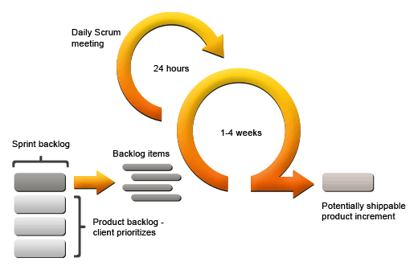
Scrum Model
Testing in Scrum model:
Delivery cycles are short. Development is very focused. Diagrams,
use cases, user stories, index cards, or discussions of functionality
serve are “documentation” to test against.
Usually have more unit testing by developers.
Dynamic nature of development needs structured regression testing.
Main testing is often ad-hoc, but focused.

Slide 7
Testing Phases and Milestones
Phase:
A time block within the Software Development Lifecycles. There are a number of activities that
have to be done in each time block.
Milestones:
A significant event in the software developing process in which, the software moves from one
phase to another. The milestone let us know where the application is in the SDLC.
Criteria: Built or created from the standard of the project.

Slide 8

Which model should we choose for your project?

Slide 9
Software Testing Overview
Testers responsibility
Objectives of Testing
Basic Testing Terminologies
Test Coverage
Manual Testing & Automated Testing

Slide 10

Testers responsibility
Typical Responsibilities of a Tester (QC):
Find Problems
Find bugs, design issues.
Find more efficient ways to find bugs.
Communicate Problems
Report bugs and design issues.
Report on testing progress.
Evaluate and report the program’s stability.
Manage/Supervise Testing process
Estimation & Preparation (test plans, schedules, tasks, time).
Measure and report testing progress against milestones.
Train other testers to find bugs.

Slide 11
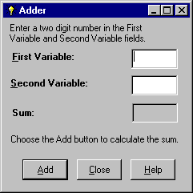
Objectives of Testing
The program’s specification:
This program is designed to add two numbers, which you will enter.
Each number should be one or two digits.

Slide 12
Quick question
Objective of testing is verify the program
works correctly?
To Find Problems.
A test that reveals a problem is a success. A test that did not reveal
a problem is (often) a waste of time!
The Purpose of Finding Problems to?
Get Them Fixed
The best tester is not the one who finds the most bugs or who embarrasses the most programmers
The best tester is the one who gets the most bugs fixed

Slide 13

Opinion of Developer and Tester
Relationship of developer and Tester?
What would you do if:
- Tester said This is a bug
- But a developer said this is NOT a bug
How is a “Good” developer and a “Good” tester?

Slide 14
Basic Testing Terminologies
Test method: is a definitive procedure that produces a test result( White-box, Black-box, Grey-box)
Scope of Testing: specifies the type of the quality objective and the level of acceptability for each objective
Test Strategy: describes how you will test the application
Test Type: The way we execute Test case, a group of test cases together to reach an objective
Test Suite: a collection of test cases, used for a properly goal of each round of testing. It often also contains more
detailed instructions or goals
Test Plan: A management document outlining risks, priorities, and schedules for testing. A document prescribing
the approach to be taken for intended testing activities
Test Case: A test that (ideally) executes a single well defined test objective, with a specific of test data and
associated procedures developed for a particular objective
Bug Report: document describes the software error that found during the testing, with specific test data and detailed
procedures that cause the error. This is the main communication channel. Make it effectiveness
White-box: Test Cases & Tests design based on the knowledge of the code to exercising the code (Doug Hoffman).
Black-box: Focus on input, outputs, and an “externally derived” theory of operation, from the customer’s view (Cem Kaner).
Grey-box: Testing involving inputs, outputs, but test design is educated by information about the code and the program operation of a kind that would normally be out of scope of the view of the tester.

Slide 15
Test Coverage
Coverage: measures of the amount of testing done of a certain type
Basic or simplistic, coverage is the percentage of product “tested” based on some aspects of the project
Coverage = | # of tests executed
 | Total # of tests
Various aspects of coverage: Function coverage, Condition coverage, Path coverage, Test coverage
How much Testing is enough?
When will we stop testing?
Function coverage: Has each function in the program been tested?
Condition coverage: Has each evaluation point (such as a true/false decision) been tested?
Path coverage: Has every possible route been tested?
Test coverage: Has every designed TCs been executed?
Stop testing is a business decision

Slide 16

Manual Testing And Automation Testing
.
Manual Testing
Automated Testing
Performed by carrying out all the
actions manually step by step, and
revealing whether a particular step was
successfully or failing.
Using of software to control the execution
of tests, and the comparison of actual outcomes
with the expected (specified) outcomes.
Always a part of any testing effort. It is
especially useful in the initial phase of
software development.
Commonly, it involves automating a manual
process already in place that uses a formalized
testing process.

Slide 17
We should choose Manual Testing or Automation Testing

Slide 18

Thanks for your listening

